Slide 1
L14 – Wireless Networks II
50.012 Networks
Jit Biswas
Cohort 1: TT7&8 (1.409-10)
Cohort 2: TT24&25 (2.503-4)

Slide 2
Introduction
This lecture:
  Frequency and Code Spreading
    Visualization of spreading codes
    Additional details on wireless channels and frequencies
  802.11 in more detail
    Access Points
    802.11 frames
    Channel access with RTS/CTS

Slide 3
Wireless Link Characteristics (1)
important differences from wired link ….
  decreased signal strength: radio signal attenuates as it propagates through matter (path loss)
  interference from other sources: standardized wireless network frequencies (e.g., 2.4 GHz) shared by other devices (e.g., phone); devices (motors) interfere as well
  multipath propagation: radio signal reflects off objects ground, arriving ad destination at slightly different times
…. make communication across (even a point to point) wireless link much more “difficult”

Slide 4
Wireless Link Characteristics (II)
SNR: signal-to-noise ratio
  larger SNR – easier to extract signal from noise (a “good thing”)
SNR versus BER tradeoffs
  given physical layer: increase power -> increase SNR->decrease BER
  given SNR: choose physical layer that meets BER requirement, giving highest thruput
    SNR may change with mobility: dynamically adapt physical layer (modulation technique, rate)
10⁻¹
10⁻²
10⁻³
BER
10⁻⁴
10⁻⁵
10⁻⁶
10⁻⁷
10
20
30
40
SNR(dB)
QAM256 (8 Mbps)
QAM16 (4 Mbps)
BPSK (1 Mbps)
Source: Based on Kurose & Ross slide set

Slide 5
More on Channel Partitioning
In TDMA, channel access is provided by time slots
  Trade-off is "time available to send" vs. "error rate"
FDMA and CDMA are other popular schemes to ensure the parallel transmission are not interfering
Fundamental problem:
  Multiple parallel uncoordinated transmissions
  No temporal alignment of message start or end
  Signals "add" together at the receiver
How to ensure that the receiver can select specific source?

Slide 6
FDMA
In Frequency Division Multiple Access, each node can be assigned one channel
  If several frequency channels are available
  No collisions are possible, similar to TDMA
Typically, there are only few channels
  Time sharing can be used in addition to channel sharing
No/less time sync is required for FDMA compared to TDMA
Typical applications: satellite communication

Slide 7
CDMA

Slide 8
Code Division Multiple Access (CDMA)
unique “code” assigned to each user; i.e., code set partitioning
  all users share same frequency, but each user has own “chipping” sequence (i.e., code) to encode data
  allows multiple users to “coexist” and transmit simultaneously with minimal interference (if codes are “orthogonal”)
encoded signal = (original data) X (chipping sequence)
decoding: inner-product of encoded signal and chipping sequence
Source: Based on Kurose & Ross slide set

Slide 9
CDMA
In Code Division Multiple Access, each node uses unique spreading code
  The spreading code enables receiver to identify specific sender
  Coding increases received signal strength from target sender, decreases other sender’s signals
  Details on spreading codes are outside scope of this lecture
    But we will give you a short introduction now

Slide 10

Codes used in CDMA
Application of code in CDMA is called spreading
To spread a data bit d_{i} , the outer product of it and a code sequence c_{m} is computed
The resulting signal is transmitted: Z_{i,m} = d_{i} * c_{m}
Despreading is done similarly, using the inner (dot) product
Codes used for CDMA need to have special properties
  Each code needs to be orthogonal to other codes in this set
  That means its inner product should be small, ideally 0
802.11 uses a similar code as spreading code
  11 bit Barker sequence: 1 -1 1 1 -1 1 1 1 -1 -1 -1
  Code is not used for CDMA, only to improve separation from other communication standards

Slide 11
CDMA encode/decode
channel output Z_{i,m}
Z_{i,m}= d_{i}.c_{m}
data
bits
d₀ = 1
1
1
1
1
1
d₁ = -1
1
1
1
-
-
-
-
1
-
-
-
1
-
1
1
1
1
1
sender
1
1
slot 1
channel
output
slot 0
channel
output
1
1
1
1
1
code
1
1
-
-
-
1
-
1
1
1
-
-
-
1
-
1
1
1
slot 1
slot 0
M
D_{i} = Σ Z_{i,m}.c_{m}
m=1
M
received
input
1
1
1
1
1
1
1
1
d₀ = 1
-
-
-
-
1
-
-
-
1
-
1
1
1
1
1
receiver
1
d₁ = -1
1
slot 1
channel
output
slot 0
channel
output
1
1
1
1
1
code
1
1
-
-
-
1
-
1
1
1
-
-
-
1
-
1
1
1
slot 1
slot 0
Wireless, Mobile Networks
6-<number>

Slide 12
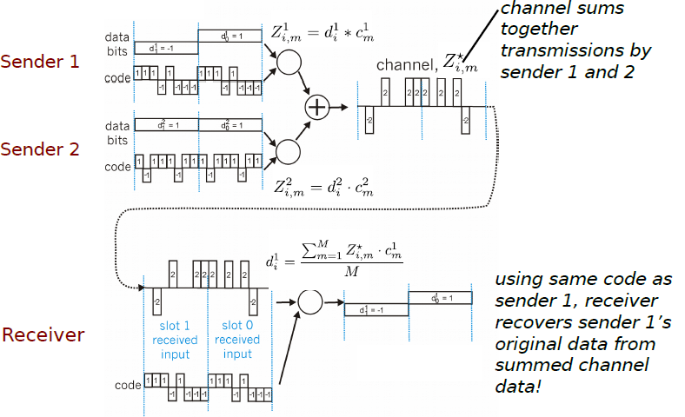
CDMA Encode / Decode
Source: Based on Kurose & Ross slide set

Slide 13




















Elements of a wireless network
network
infrastructure
Source: Kurose & Ross slide set

Slide 14

Elements of a wireless network
base station
typically connected to wired network
relay - responsible for sending packets between wired network and wireless host(s) in its “area”
  e.g., cell towers, 802.11 access points
network
infrastructure
Source: Kurose & Ross slide set

Slide 15



Elements of a wireless network
wireless hosts
laptop, smartphone
run applications
may be stationary (non-mobile) or mobile
  wireless does not always mean mobility
network
infrastructure
Source: Kurose & Ross slide set

Slide 16
Elements of a wireless network
wireless link
typically used to connect mobile(s) to base station
also used as backbone link
multiple access protocol coordinates link access
various data rates, transmission distance
network
infrastructure
Source: Kurose & Ross slide set

Slide 17
Elements of a wireless network
infrastructure mode
base station connects mobiles into wired network
handoff: mobile changes base station providing connection into wired network
network
infrastructure
Source: Kurose & Ross slide set

Slide 18



Elements of a wireless network
ad hoc mode
no base stations
nodes can only transmit to other nodes within link coverage
nodes organize themselves into a network: route among themselves
Source: Kurose & Ross slide set

Slide 19
802.11 Wireless LAN

Slide 20
802.11 Overview
Family of layer 1 and layer 2 protocols defined by IEEE 802 group
  Also marketed as "Wi-Fi", term carries no actual meaning
  All use CSMA/CA for channel access
  RTS used in addition to ACK scheme introduced last lecture
802.11b introduced in 2000, 2.4 GHz carrier, 11Mbit
802.11a added channels in 5-6GHz range
  5GHz carrier, up to 54 MBit/s data rate
802.11g introduced 54MBit/s in 2.4 GHz
802.11n introduced MIMO in 2.4 and 5 GHz
802.11n further improved MIMO in 2.4 and 5 GHz

Slide 21
IEEE 802.11 Wireless LAN
802.11b
2.4-5 GHz unlicensed spectrum
up to 11 Mbps
direct sequence spread spectrum (DSSS) in physical layer
  all hosts use same chipping code
802.11a
  5-6 GHz range
  up to 54 Mbps
802.11g
  2.4-5 GHz range
  up to 54 Mbps
802.11n: multiple antennae
  2.4-5 GHz range
  up to 200 Mbps
all use CSMA/CA for multiple access
all have base-station and ad-hoc network versions
Source: Kurose & Ross slide set

Slide 22
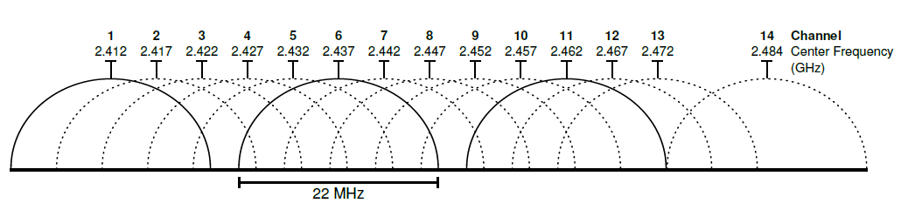
802.11b Channel Use
802.11b was first introduced in 2000
  11Mbit data rate
  13(+1) separate channels, spaced 5MHz apart
    Channel 1 at 2412 MHz
    Channel 13 at 2472 MHz
  Channels cause interference for up to 11 MHz in each direction
    Ideally, only channel 1, 7 and 13 are used
    Outside US, channel 1, 5, 9 and 13 are also possible
802.11b channels, source: Wikipedia

Slide 23




802.11 LAN architecture
wireless host communicates with base station
  base station = access point (AP)
Basic Service Set (BSS) (aka “cell”) in infrastructure mode contains:
  wireless hosts
  access point (AP): base station
  ad hoc mode: hosts only
Internet
hub, switch
or router
BSS 1
BSS 2
Source: Based on Kurose & Ross slide set

Slide 24
Access Points
In 802.11, clients have to actively associate to APs
Each AP is identified by a Basic Service Set ID (BSSID)
  The MAC address of the AP’s radio
Multiple APs can form a logical network, identified by the Extended Service Set ID (ESSID)
  Example: SUTD_Student is used by many APs
  All APs in the ESS should have same access control and IP network
  Nodes can then seamlessly switch from one associated AP to another one

Slide 25
802.11: Channels, association
802.11b: 2.4GHz-2.485GHz spectrum divided into 11 channels at different frequencies
  AP admin chooses frequency for AP
  interference possible: channel can be same as that chosen by neighboring AP!
host: must associate with an AP
  scans channels, listening for beacon frames containing AP’s name (SSID) and MAC address
  selects AP to associate with
  may perform authentication [Chapter 8]
  will typically run DHCP to get IP address in AP’s subnet
Source: Kurose & Ross slide set

Slide 26
Association to Access Points
Access points in range can be found through active or passive scanning
  Active: Node sends out probe request frames, AP replies
  Passive: AP sends out periodic beacon frames
To associate with the AP, the client send association requests
  AP respond with an association response frames

Slide 27
802.11: passive/active scanning
BSS 1
BSS 2
BSS 1
BSS 2
1
AP 2
AP 1
1
1
AP 2
AP 1
2
2
2
3
3
4
H1
H1
passive scanning:
beacon frames sent from APs
association Request frame sent: H1 to selected AP
association Response frame sent from selected AP to H1
active scanning:
Probe Request frame broadcast from H1
Probe Response frames sent from APs
Association Request frame sent: H1 to selected AP
Association Response frame sent from selected AP to H1
Source: Kurose & Ross slide set

Slide 28
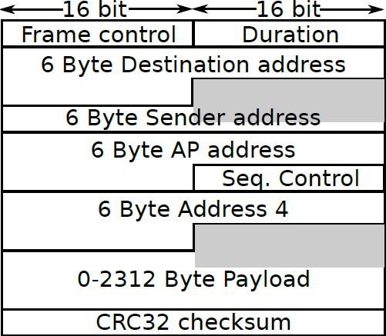
802.11 Frame Format
Note: In infrastructure mode, payload is limited to 1500 Bytes

Slide 29
802.11 frame: addressing
2
2
6
6
6
2
6
0 - 2312
4
frame
control
duration
address
1
address
2
address
3
seq
control
address
4
payload
CRC
Address 4: used only in ad hoc mode
Address 1: MAC address
of wireless host or AP
to receive this frame
Address 3: MAC address
of router interface to which AP is attached
Address 2: MAC address
of wireless host or AP
transmitting this frame

Slide 30

802.11 frame: addressing
Internet
H1
R1
router
R1 MAC addr H1 MAC addr
dest. address
source address
802.3 frame
AP MAC addr H1 MAC addr R1 MAC addr
address 1
address 2
address 3
802.11 frame

Slide 31
802.11 frame: more
frame seq #
(for RDT)
duration of reserved
transmission time (RTS/CTS)
2
2
6
6
6
2
6
0 - 2312
4
frame
control
duration
address
1
address
2
address
3
seq
control
address
4
payload
CRC
2
2
4
1
1
1
1
1
1
1
1
Protocol
version
Type
Subtype
To
AP
From
AP
More
frag
Retry
Power
mgt
More
data
WEP
Rsvd
frame type
(RTS, CTS, ACK, data)

Slide 32
Addressing in 802.11
802.11 frame is similar, but extended compared to 802.3
802.11 uses "normal" 802 MAC addresses
Frames actually contain 3 addresses:
  Target MAC
  Sender MAC
  AP MAC
  An optional fourth address in ad-hoc mode
In infrastructure mode, a wireless host will fill all three fields
The access point then translates to 802.3 frame and removes the AP address
A frame sent from wired to wireless host will be translated by AP
  AP will accept and process frames addressed to wireless host MAC
  AP will translate 802.3 frame to 802.11, add its own MAC address, send it via radio

Slide 33
IEEE 802.11 MAC Protocol: CSMA/CA
802.11 sender
1 if sense channel idle for DIFS¹ then
  transmit entire frame (no CD)
2 if sense channel busy then
  start random backoff time
  timer counts down while channel idle
  transmit when timer expires
  if no ACK, increase random backoff interval, repeat 2
802.11 receiver
- if frame received OK
return ACK after SIFS¹ (ACK needed due to hidden terminal problem)
sender
receiver
DIFS
data
SIFS
ACK
Source: Kurose & Ross slide set
¹ DIFS – distributed inter frame spacing
SIFS – short inter frame spacing

Slide 34




IEEE 802.11: multiple access
avoid collisions: 2⁺ nodes transmitting at same time
802.11: CSMA - sense before transmitting
  don’t collide with ongoing transmission by other node
802.11: no collision detection!
  difficult to receive (sense collisions) when transmitting due to weak received signals (fading)
  can’t sense all collisions in any case: hidden terminal, fading
  goal: avoid collisions: CSMA/C(ollision)A(voidance)
A
B
C
C
B
A’s signal
strength
C’s signal
strength
A
space
Source: Kurose & Ross slide set

Slide 35
Avoiding collisions (more)
idea: allow sender to “reserve” channel rather than random access of data frames: avoid collisions of long data frames
sender first transmits small request-to-send (RTS) packets to BS using CSMA
  RTSs may still collide with each other (but they’re short)
BS broadcasts clear-to-send CTS in response to RTS
CTS heard by all nodes
  sender transmits data frame
  other stations defer transmissions
avoid data frame collisions completely
using small reservation packets!
Source: Kurose & Ross slide set

Slide 36
Collision Avoidance: RTS-CTS exchange
A
B
AP
RTS(B)
RTS(A)
reservation collision
RTS(A)
CTS(A)
CTS(A)
DATA (A)
defer
time
ACK(A)
ACK(A)
Source: Kurose & Ross slide set

Slide 37
Animations of 802.11 CSMA/CA with and without hidden terminal
http://www.ccs-labs.org/teaching/rn/animations/csma/

Slide 38

802.11: mobility within same subnet
H1 remains in same IP subnet: IP address can remain same
switch: which AP is associated with H1?
  self-learning (Ch. 5): switch will see frame from H1 and “remember” which switch port can be used to reach H1
BSS 1
H1
BSS 2
Source: Kurose & Ross slide set

Slide 39
Infrastructure Mode Security
APs can be configured to be "open", i.e. use no access control
Alternatively, APs can require user authentication and provide confidentiality and integrity based on a shared temporal key
Original security for 802.11 was Wired Equivalent Privacy (WEP)
  Was quickly broken in 2001 (stream cipher with short IV)
WEP was improved to Wi-Fi Protected Access (WPA) in 2003
  WPA was still flawed and susceptible to attacks
WPA2 was introduced in 2004, and is still in use
  Pre-Shared Keys (PSK) (home use)
  Mutual authentication (Enterprise/802.1x)

Slide 40
Homework 7 (due 11:59 11-10-2018)
WiFi Frame Transmission time
Suppose an 802.11g station is configured to always reserve the channel with the RTS/CTS sequence. Suppose this station suddenly wants to transmit 1,500 bytes of data, and all other stations are idle at this time. Using SIFS of 20μs and DIFS of 70μs, and ignoring propagation delay and assuming no bit errors, calculate the time required to transmit the frame and receive the acknowledgment. Assume a frame without data is 34 bytes long and the transmission rate is 54 Mbps.
Submit answer on eDimension.

Slide 41
Conclusion
We discussed
FDMA and CDMA with some examples
Frequency band and standardization
802.11
  802.11 frames
  802.11 RTS/CTS
  Access points and association
  Different 802.11 standard versions

